Slide 1
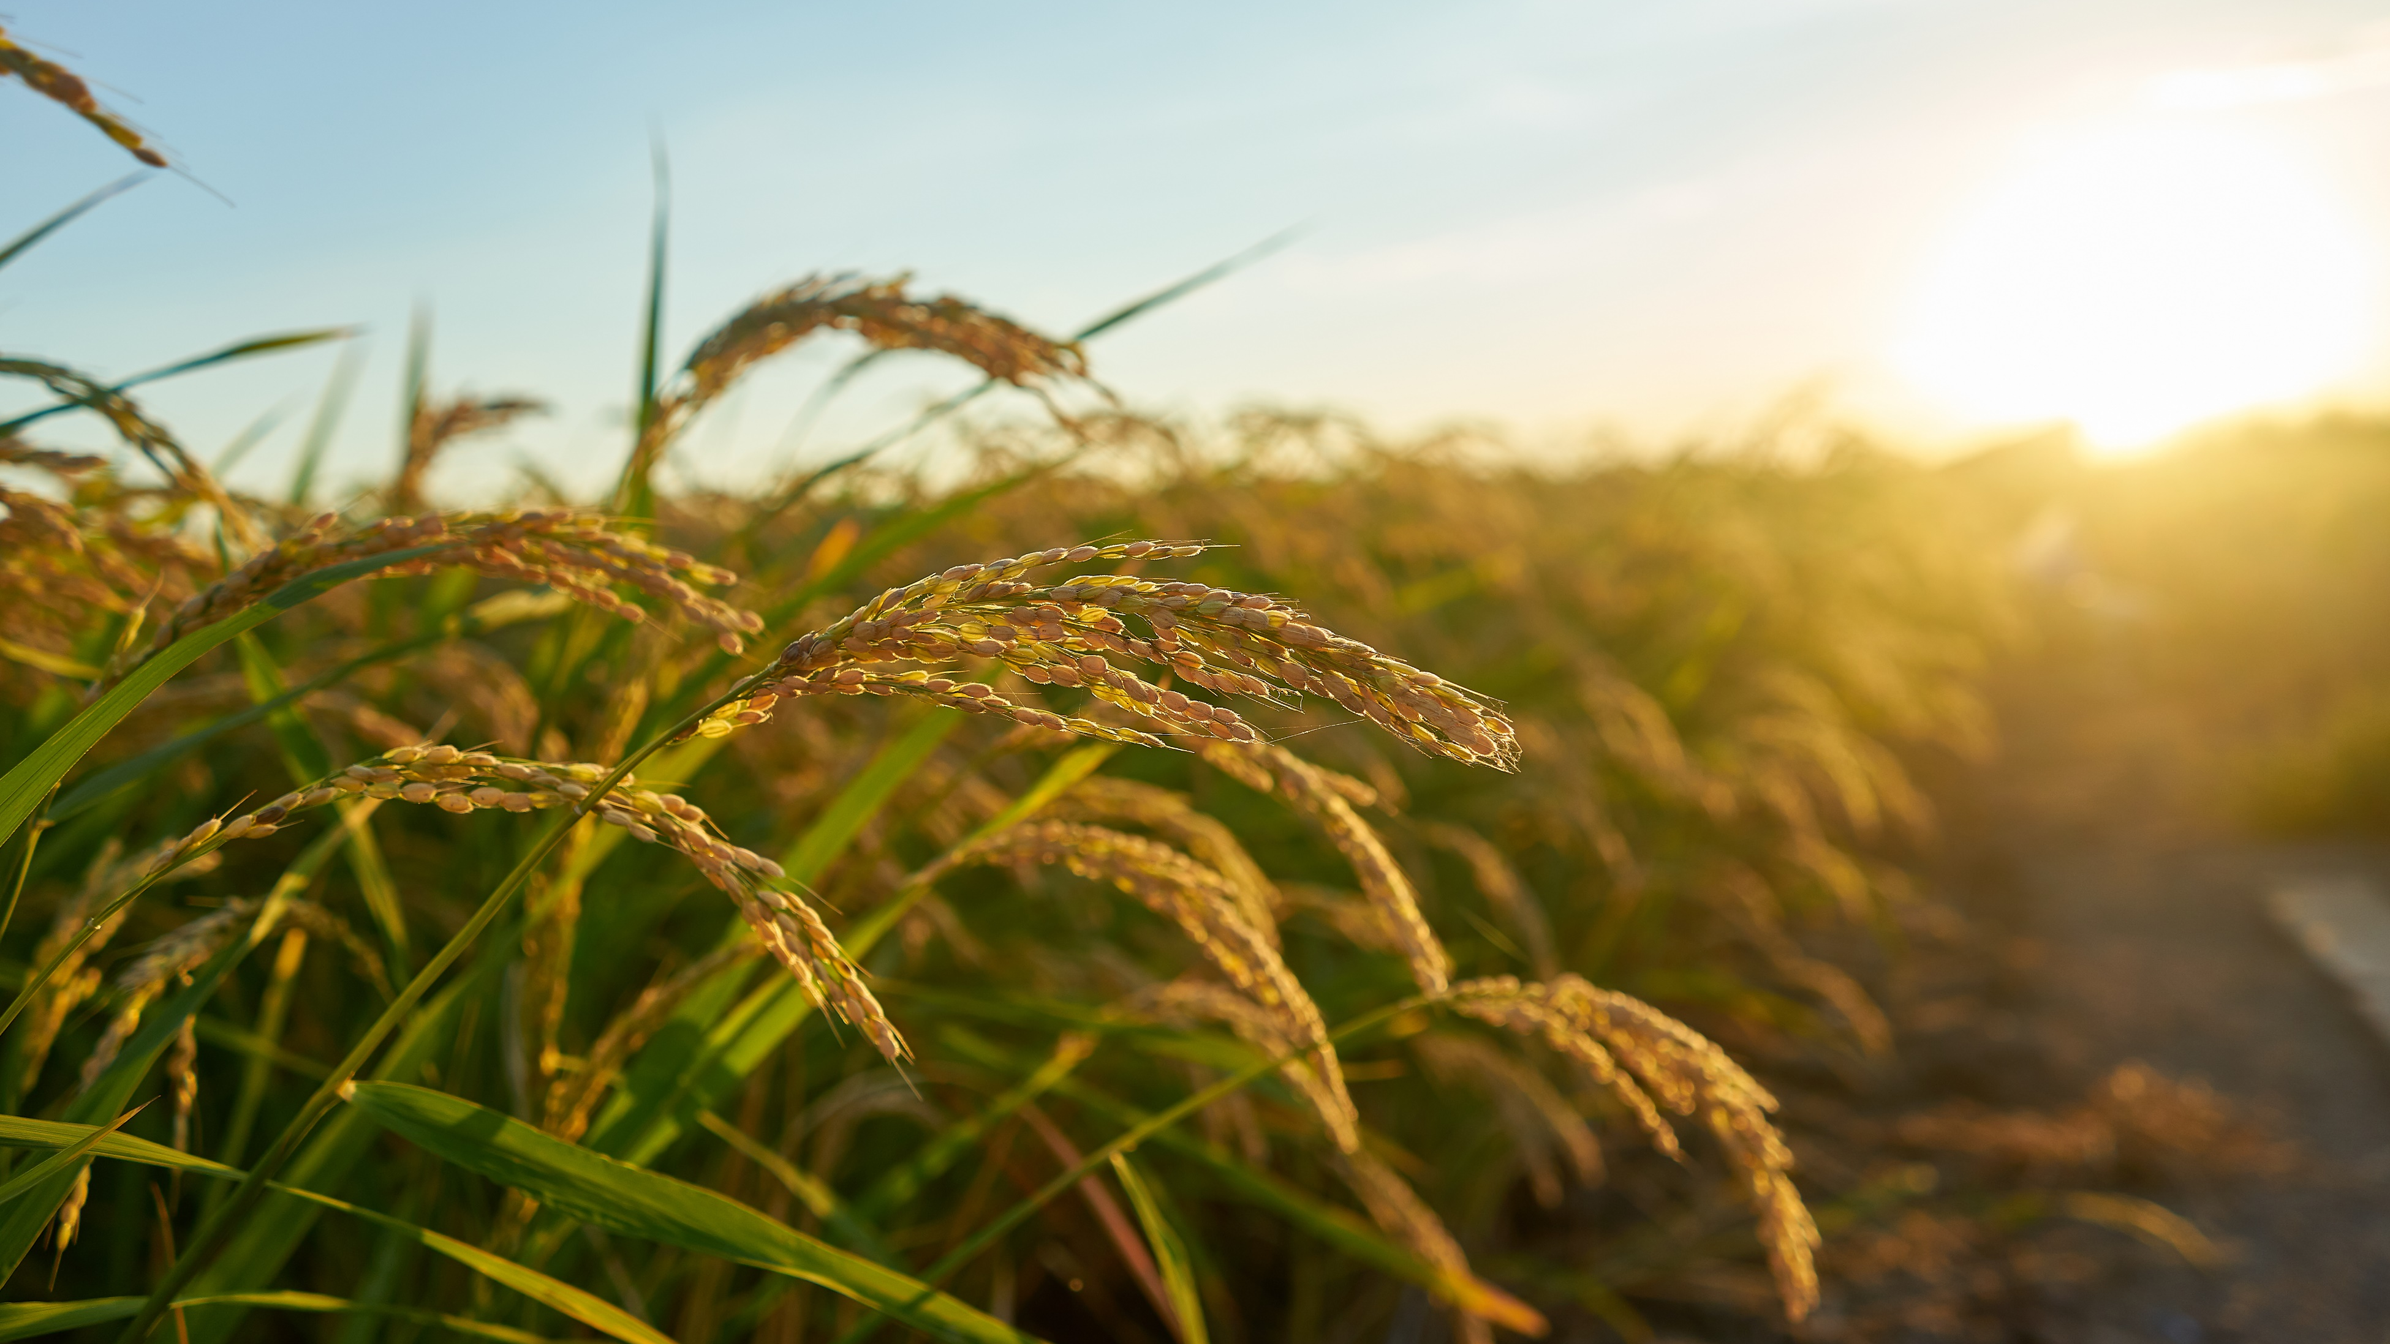
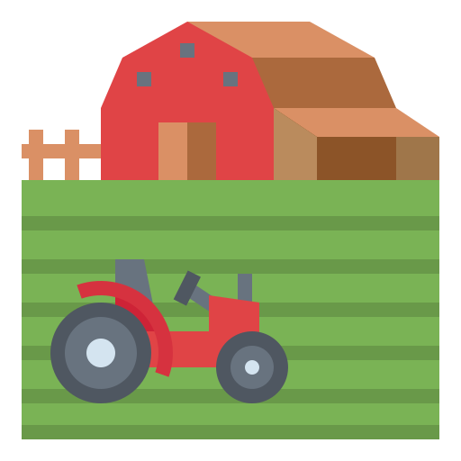
Optimizing Agricultural Plot Division Using Hill-Climbing Search
A Data-Driven Approach for Soil and Irrigation Management
Presented by: M. Akshitha
Roll no.: 23891A66G3
Dept.: AIML
Sec: Andrew (2C)

Slide 2
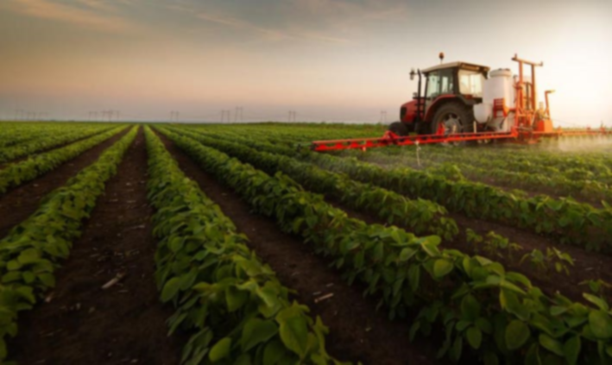

Problem Statement
Objective: "Divide agricultural land optimally to maximize crop yield using soil (N, P, K) and irrigation (rainfall, humidity) data.“
Challenges:
Manual division is inefficient.
Local optima in traditional methods.
Solution:
Hill-Climbing Algorithm to automate and optimize plot division.

Slide 3


Hill-Climbing Algorithm
Definition: "An iterative search that moves toward better solutions by evaluating neighbors.“
Steps:
Initialize: Random/K-means clustering.
Evaluate: Score using evaluate_partition().
Generate Neighbors: Slight variations of current clusters.
Select Best: Move to higher-scoring neighbor.
Terminate: If no better neighbor exists.

Slide 4

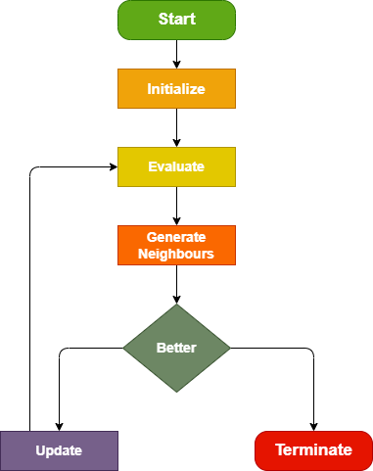
Hill-Climbing Algorithm
Yes
No

Slide 5
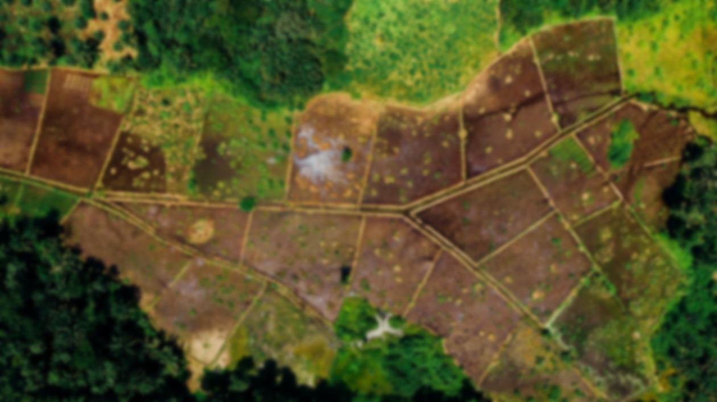
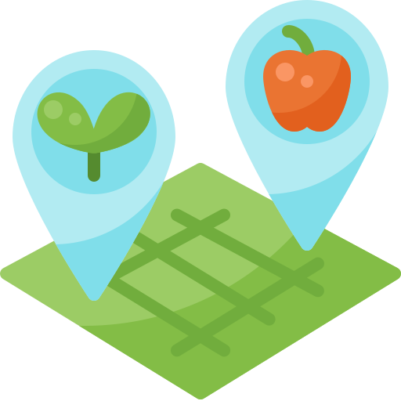
Implementation
Tools & Libraries:
Python, Pandas, Scikit-learn, Matplotlib.
Key Code Snippets:
python
def evaluate_partition(clusters, df):
"""Compute the fitness score based on crop suitability.""“
def hill_climbing(X, df, k=5, max_iterations=100):
"""Optimize plot division using Hill-Climbing."""
Dataset:
Crop_recommendation.csv (Features: N, P, K, temperature, rainfall).

Slide 6
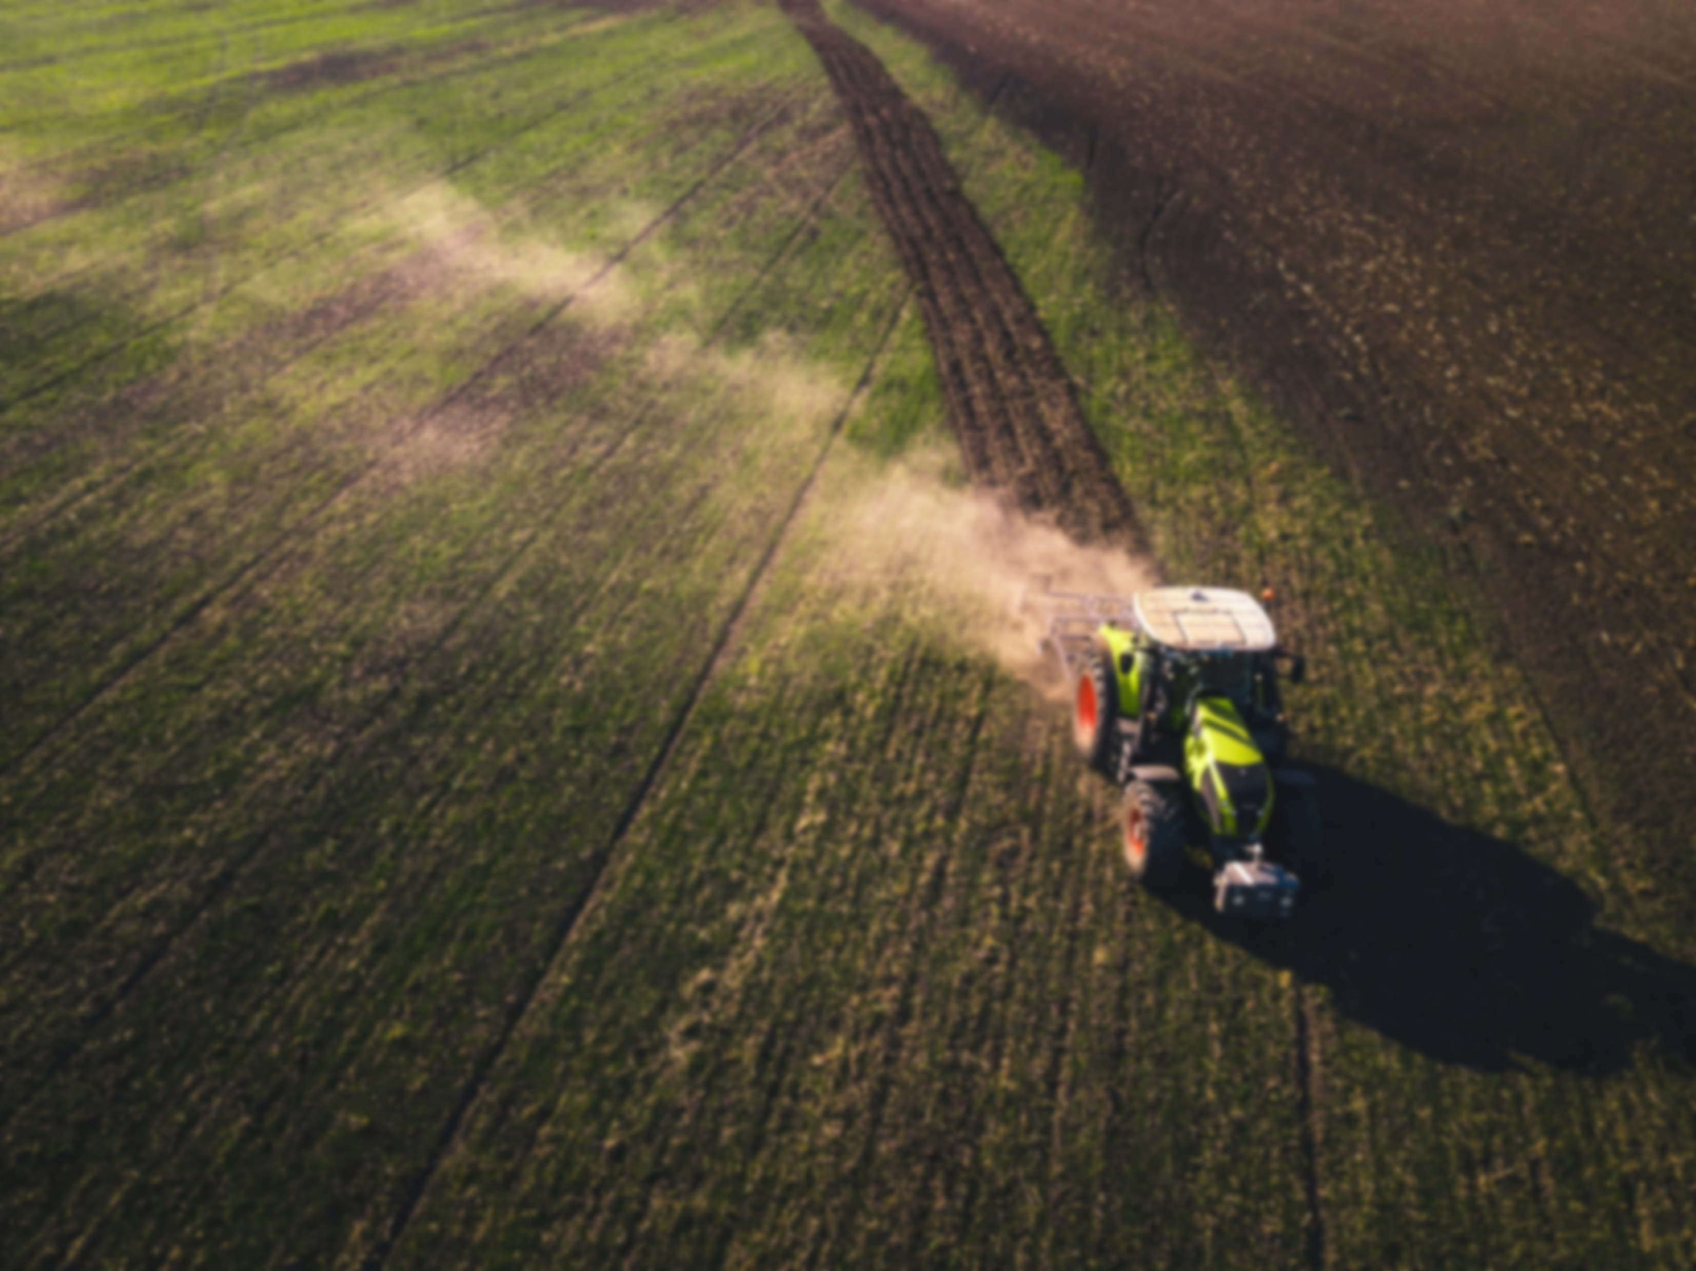
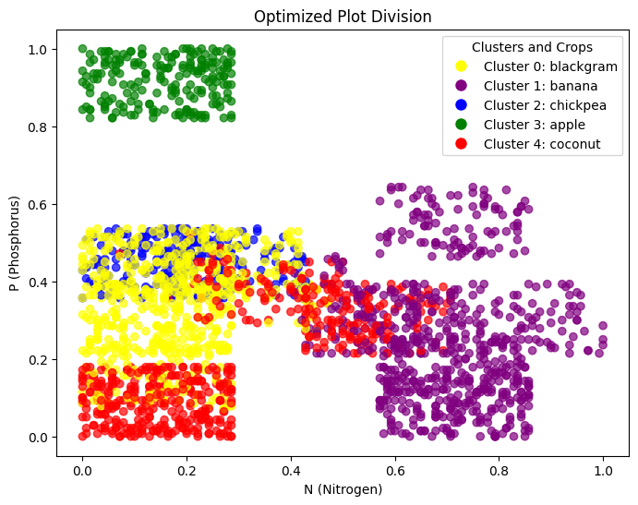
Results & Visualization
Output:
Scatter plot of optimized clusters.
Axes:
X: Nitrogen (N), Y: Phosphorus (P).
Interpretation:
Each color = cluster with similar soil/irrigation properties.
Clusters guide crop selection (e.g., Cluster 1 = Wheat, Cluster 2 = Rice).
Optimization: Addressed local optima (random restarts) and data sensitivity (MinMaxScaler) for reliable results.

Slide 7
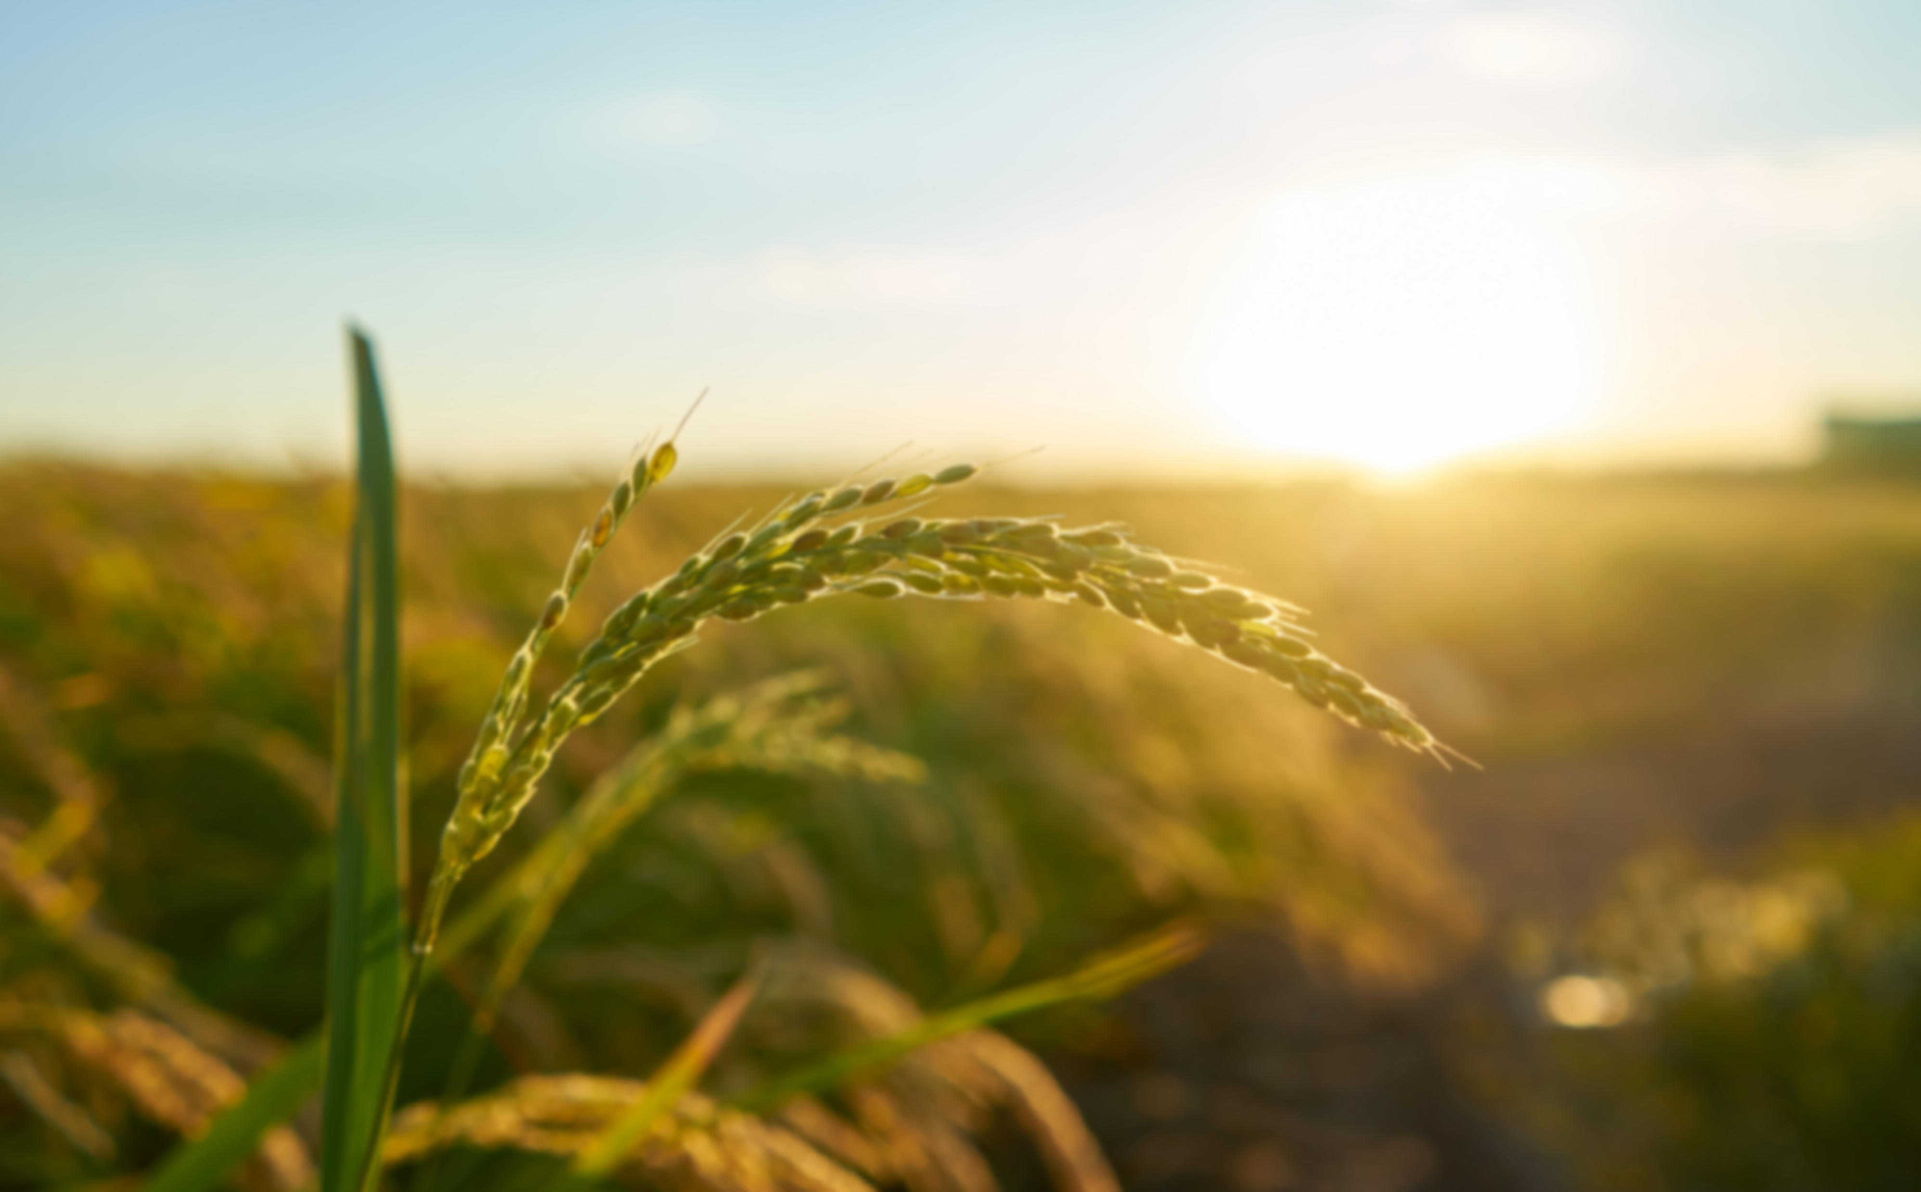

Conclusion
Summary:
Hill-Climbing automates land division for better yield.
Efficient but limited by local optima.
Future Work:
Hybrid algorithms (e.g., Genetic Algorithm + Hill-Climbing).
Real-time sensor data integration.

Slide 8
